Slide 1
MINI PROJECT 4 Blocking Semaphores and priority scheduling
William Trace LaCour (WTL6C)

Slide 2
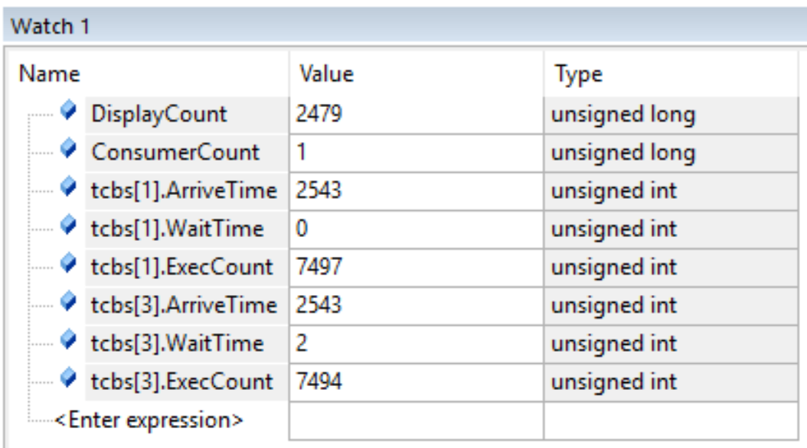
Part 1 – Experiment 1

Slide 3
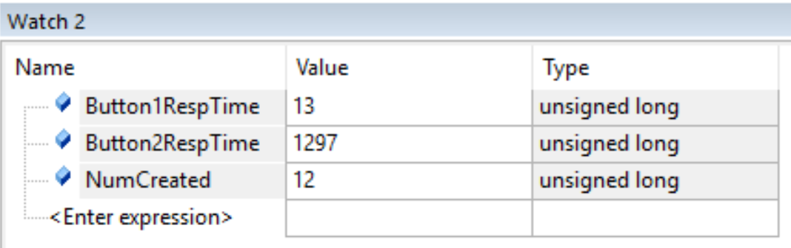
Part 1 – Experiment 2

Slide 4
Part 1 – question 1
Task 2 – top button, quick response just makes a thread
SW1 (top button) triggers buttonWork background thread
Task 3 – consumer, foreground periodic thread that accepts data from producer
Priority 1 – writing crosshairs and data to the LCD
Task 6 – display, foreground periodic thread
Priority 3 – writes the psuedoCount to the LCD
Task 7 – bottom button, slower response must delete each thread and restart
SW2 (bottom button) triggers the restart background thread

Slide 5
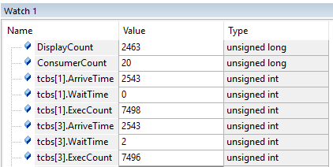
Part 1 – question 2A
BEFORE
AFTER
I added OS_Sleep(TIME_1MS) right before the OS_Kill() command in the display thread and saw little to no difference. This is most likely because of the location of the sleep command. It will only run once the Pseudo Count gets too 299. So having no difference between either experiment makes sense. The next slide will show the second experiment results. The one difference I did see was the increase in Consumer Count and that was due to the 1 ms sleep.

Slide 6
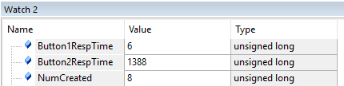
Part 1 – question 2B
BEFORE
AFTER
The response time of the button1 was about half that of the previous experiment. This was due to the sleeping of 1ms for the display thread.

Slide 7

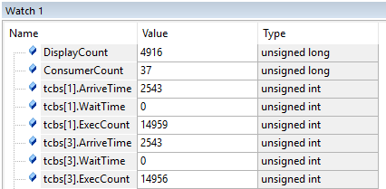
Part 1 – question 3a
BEFORE
Sleep(1ms)
OS_Suspend()
I added OS_Suspend to every foreground thread right before it finished its execution. This made the wait times all go to zero. This also increased the execution count of the foreground threads because of the cooperation from each. This is proof of the cooperative spinlock versus a non cooperative spinlock thread.

Slide 8

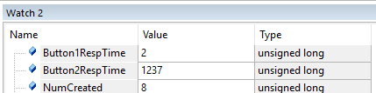
Part 1 – question 3B
BEFORE
OS_Sleep(1ms)
OS_Suspend()
Once again adding the cooperative part to the spinlock it decreased the response time even more. If a thread can’t run it simply just suspends until it can.

Slide 9
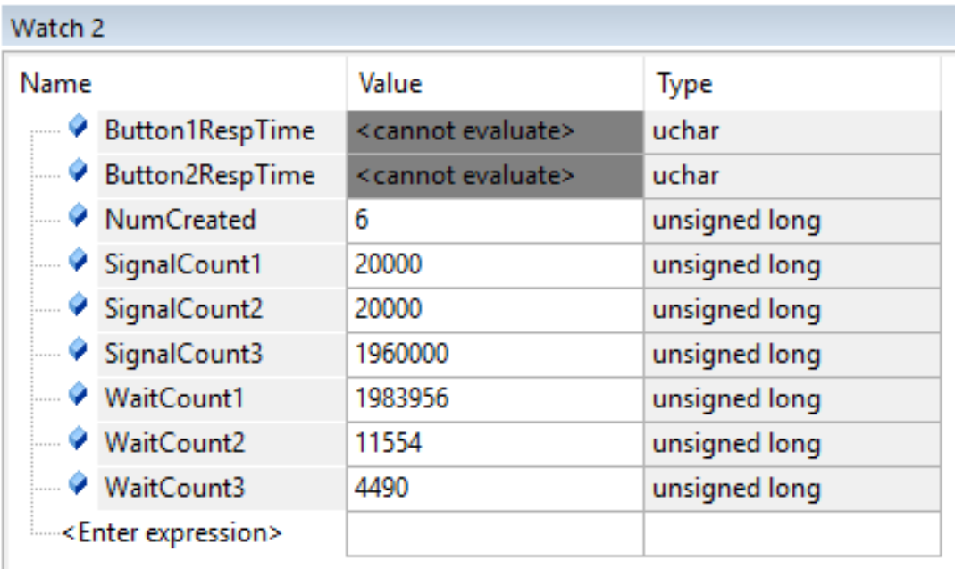
Part 2 – Experiment 1

Slide 10
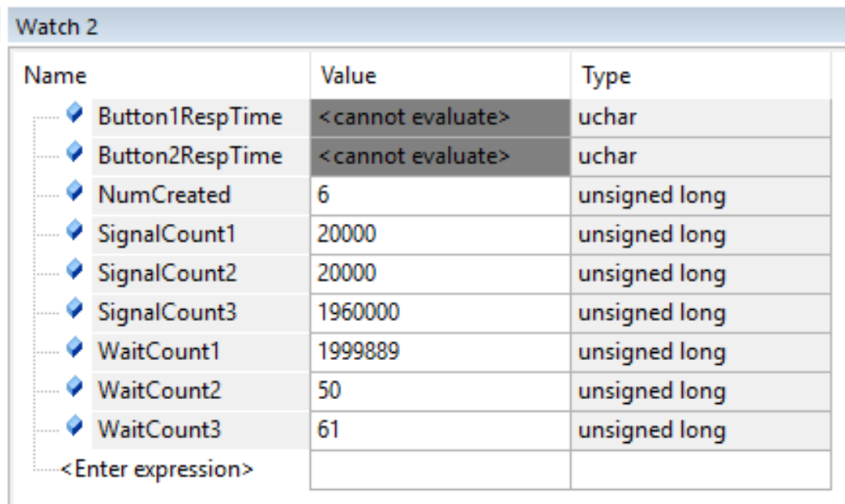
Part 2 – Experiment 2

Slide 11
Part 2 – question 1
Experiment 1
Experiment 2
Using cooperative spinlock semaphores in experiment 2 allowed for a dramatically decreased wait time for count 2 & 3 than that of the blocking semaphores in experiment 1. The total for the waits and the total for the signal in both exeriments should both be equal to 2 million.

Slide 12
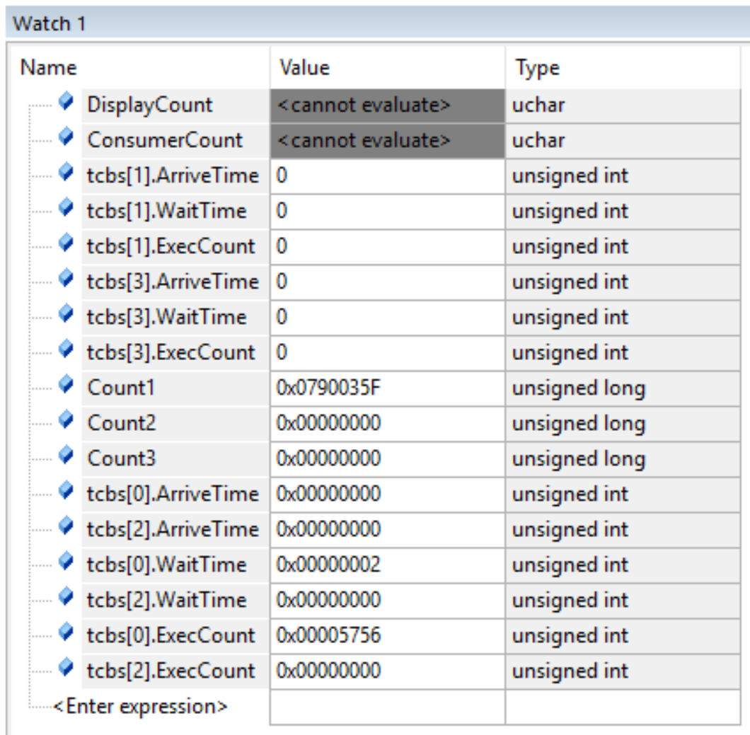
Part 3 – Experiment 1

Slide 13
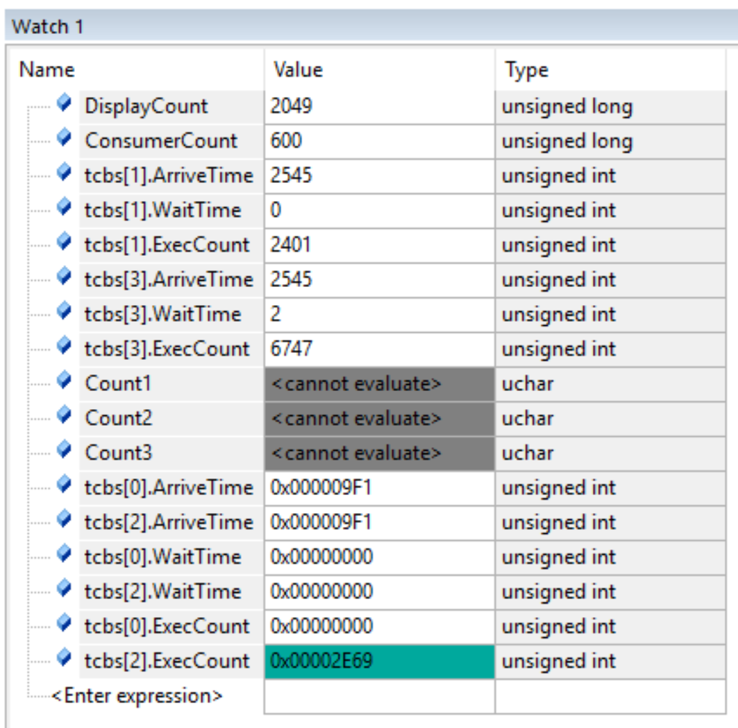
Part 3 – Experiment 2a

Slide 14

Part 3 – Experiment 2b

Slide 15
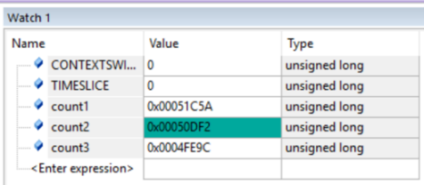
Part 3 – Question 1
Experiment 1
Mini Project 2
The count variable that we saw in mini project two ran very fairly in the fact that they were essentially equal at all times. Using the fixed priority scheduler you only are going to run the highest priority and in this case it is count 1. This is the reason for the zeros for count 2 and count 3.

Slide 16
Part 3 – question 2a
Experiment 1 Part 1
Experiment 2 Part 3
The difference is that consumer is priority one for part 3 and that means it runs a lot more. In part one we used blocking semaphores and this caused the consumer to only run once.

Slide 17
Part 3 – question 2b
Experiment 2 Part 1
Experiment 2 Part 3
Using the fixed priority scheduler the wait time was nothing for either button response. I believe they are actually running because when I hit the button threads are created. The difference being that the threads are not blocked only running in a priority based fashion.

Slide 18
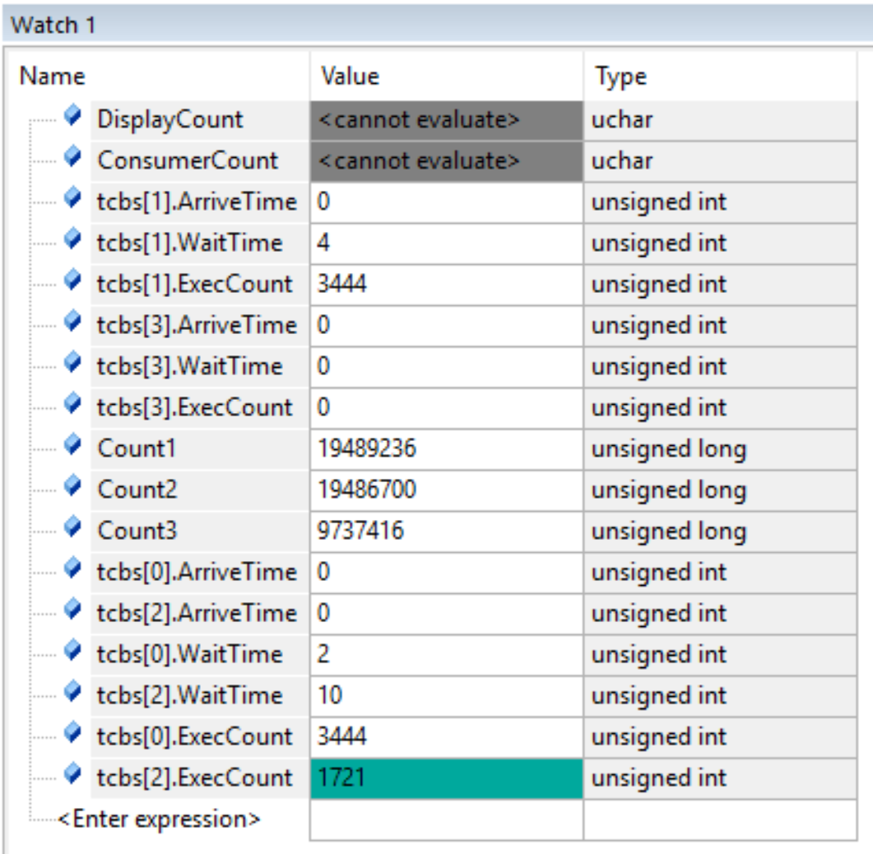
Part 4 – experiment 1

Slide 19
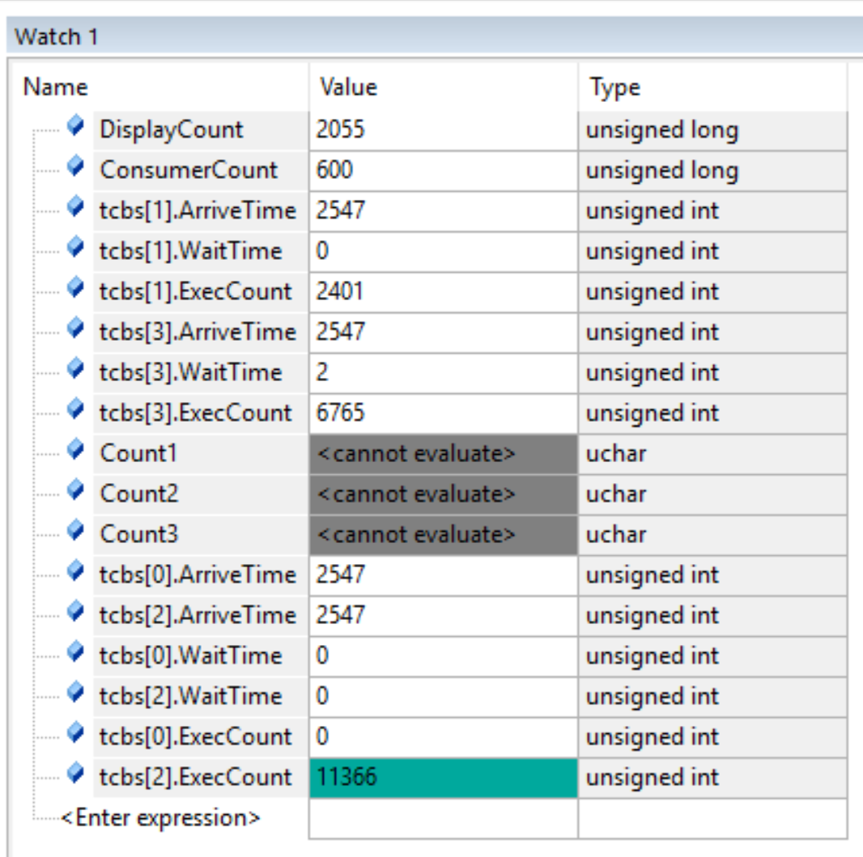
Part 4 – experiment 2a

Slide 20
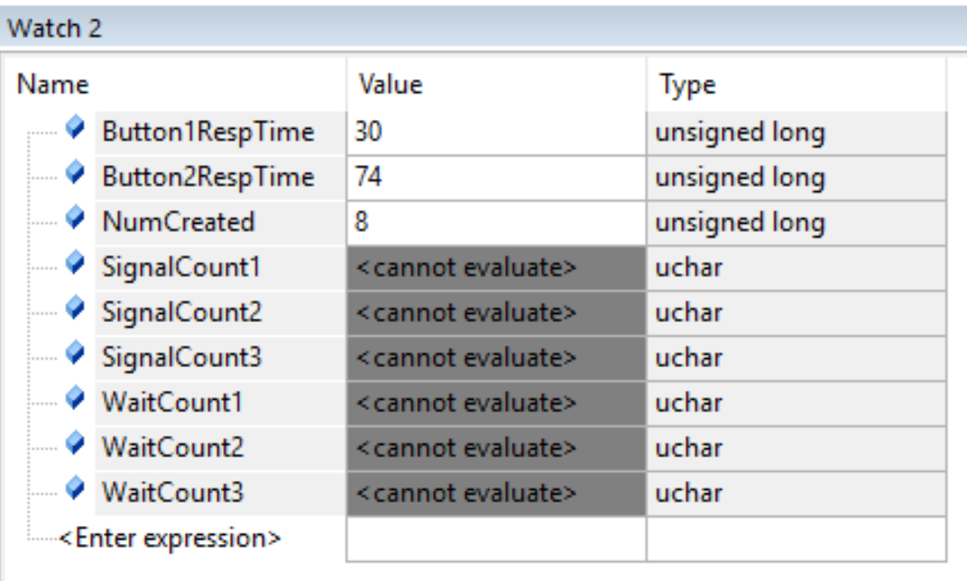
Part 4 – experiment 2b

Slide 21


Part 4 – question 1
Experiment 1 Part 4
Experiment 1 Part 3
I noticed that with the aging scheduler that even though priority 1 should be the only one running, aging the lower priority threads made them run eventually. This is why for part 4 we see that the counts are not zero like those found from part 3.

Slide 22
Part 4 – question 2a
Experiment 2A Part 4
Experiment 2 Part 1
When using the aging scheduler the consumer runs a lot more often than that of the spinlock semaphores used in part 1.

Slide 23
Part 4 – question 2b
Experiment 2B Part 4
Experiment 1 Part 1
The response time for the buttons were faster using aging if you were to average the button response times. Part 1 response time for button1 was fast but the slow response from button 2 made this a slow process. Part 4 made the response time of button 1 slower but button 2 much faster.

Slide 24


Part 4 – question 3a
Experiment 2A Part 4
Experiment 2A Part 3
I did not notice any changes as far as the counts and wait times. This seems to be correct.

Slide 25
Part 4 – question 3b
Experiment 2A Part 4
Experiment 2B Part 3
I did not notice any changes within the response times.

Slide 26
Part 4 – experiment 3 Data table
JSFIFOSIZE | TIMESLICE | Spinlock / Round Robin | Blocking / Round Robin | Blocking / Dynamic Priority
8 | 2 | 582 | 0 | 0
32 | 2 | 568 | 0 | 0
64 | 2 | 349 | 0 | 0
64 | 1 | 421 | 0 | 0
64 | 10 | 536 | 0 | 0

Slide 27
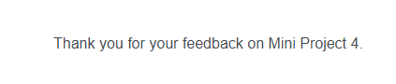
SURVEY
Thank you for the extension, life got in the way and my procrastination caught up with me. Appreciate it.

